Slide 1
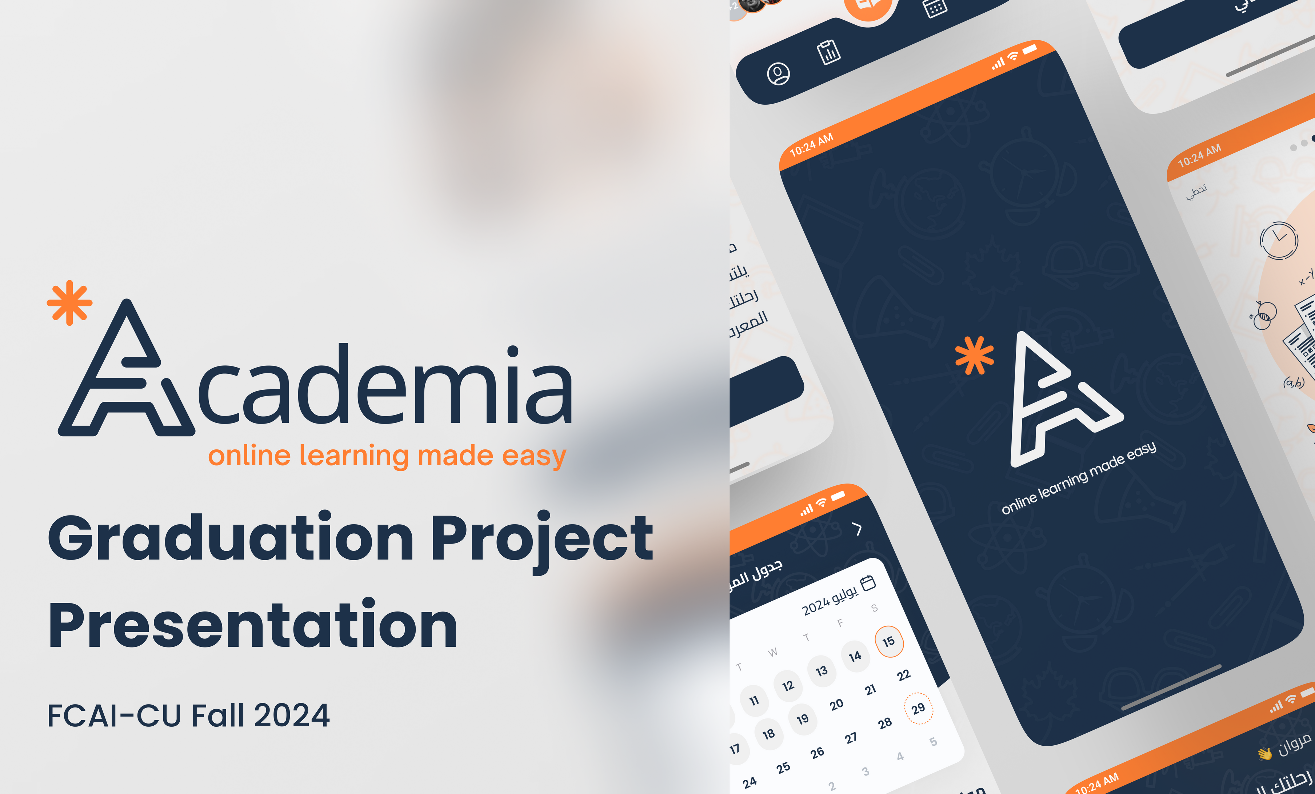
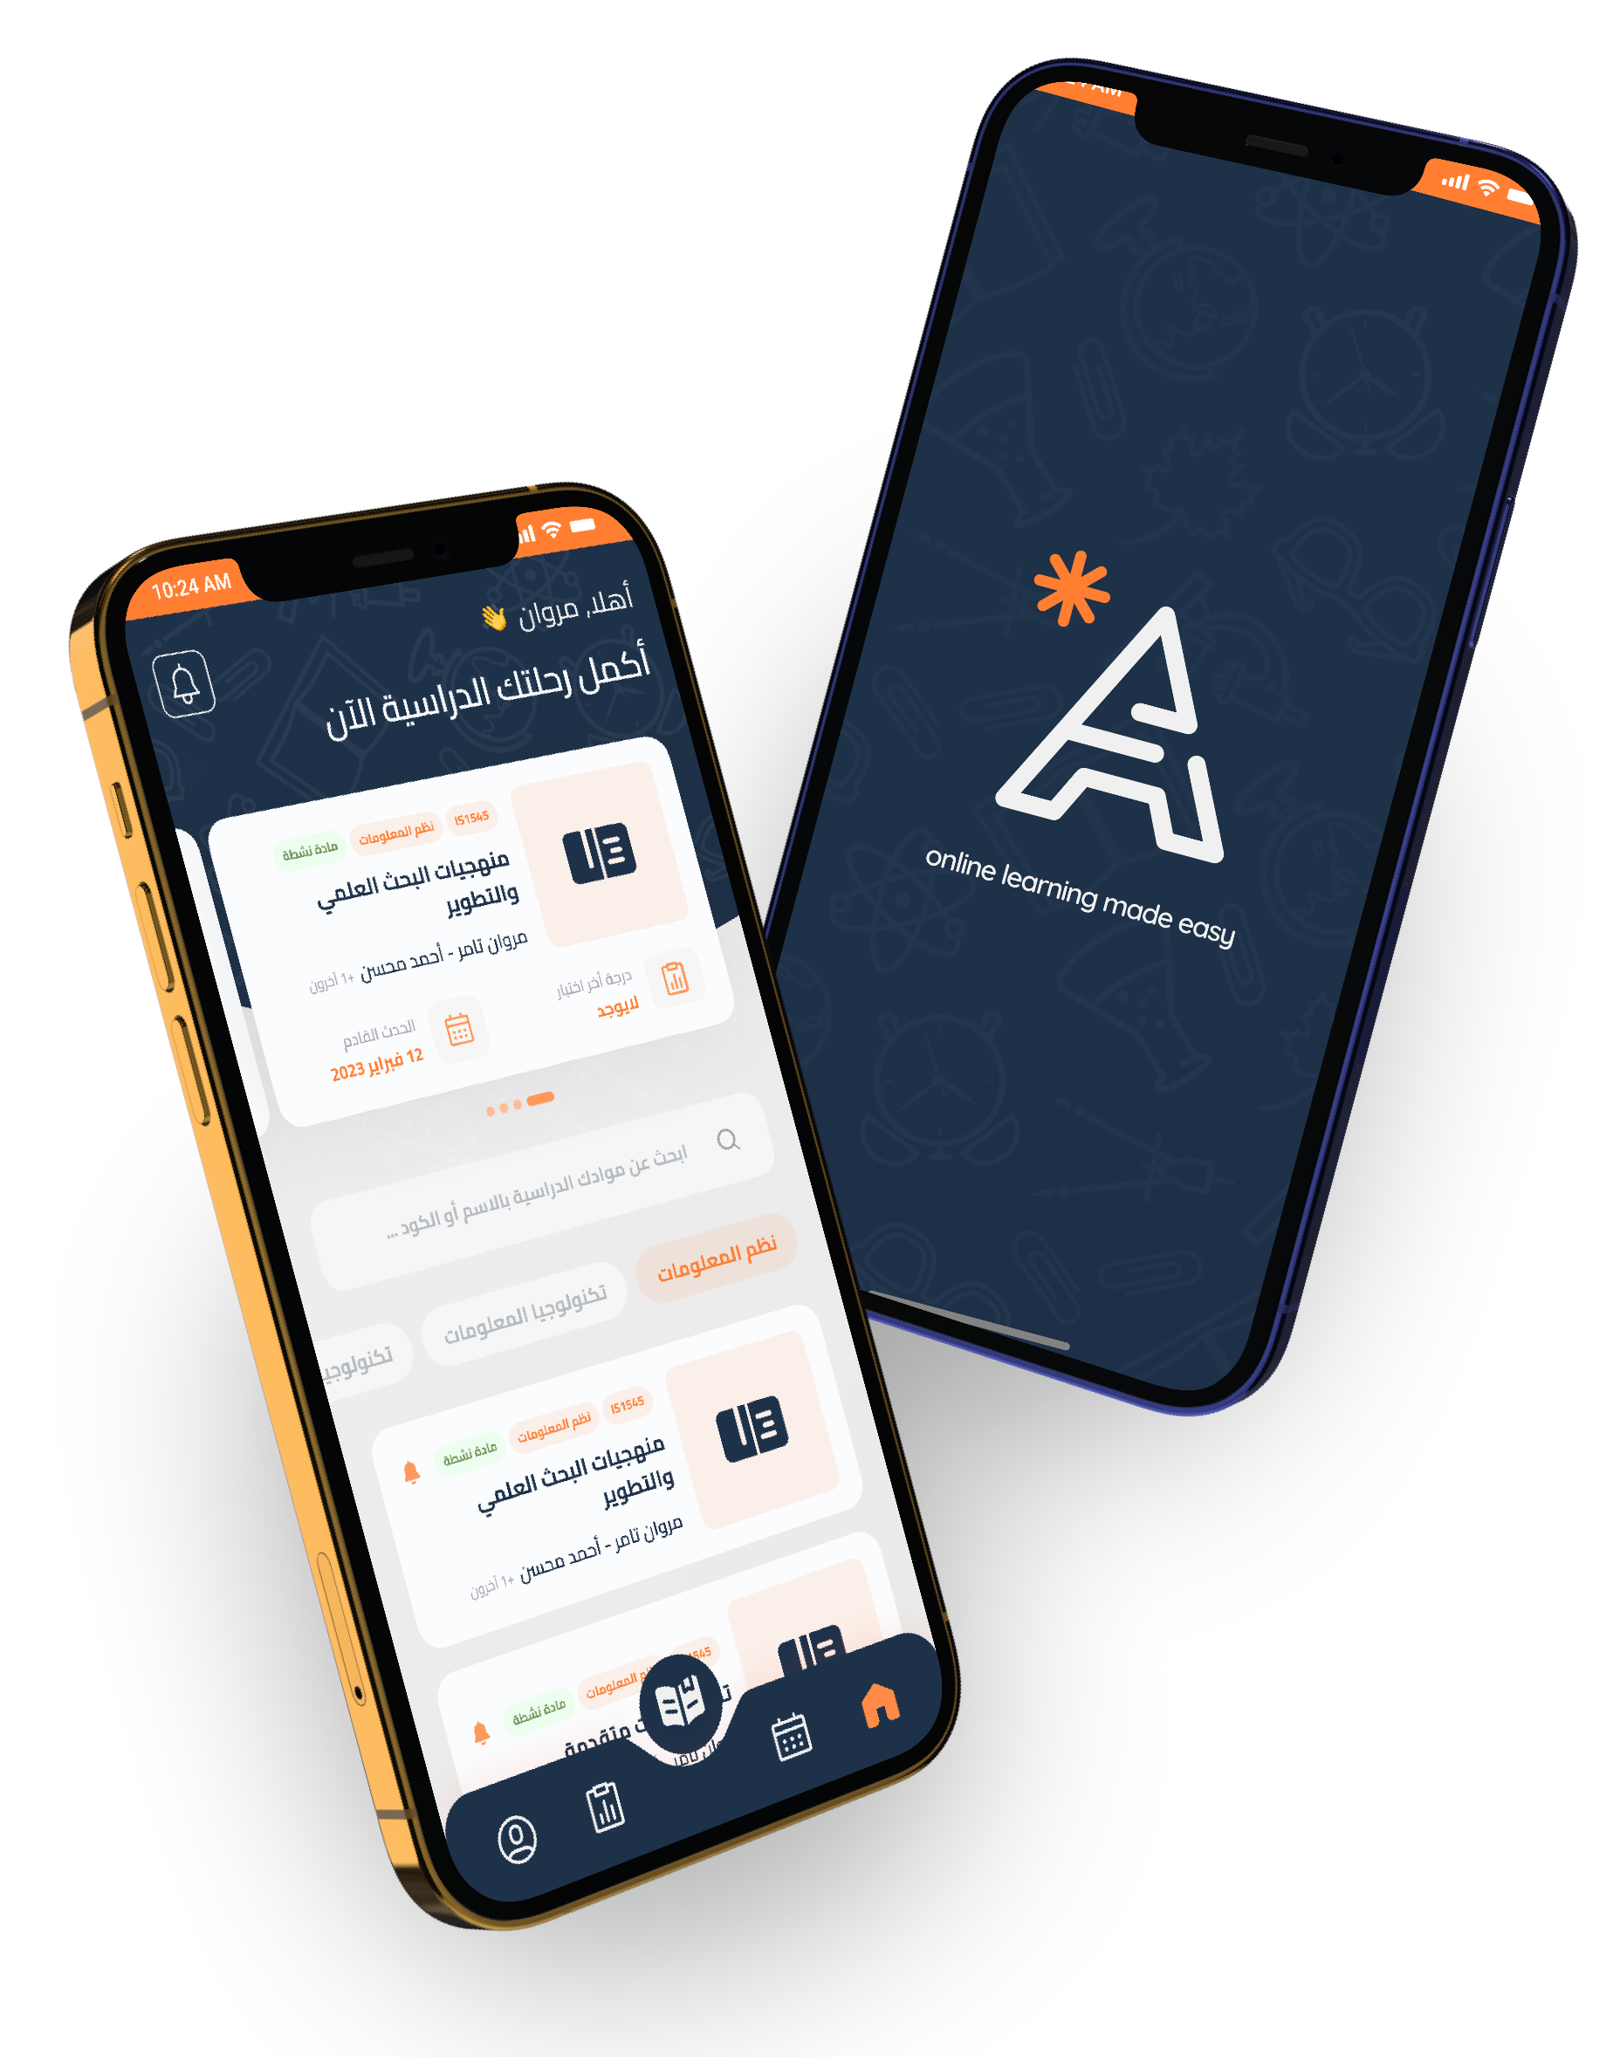


Slide 2


Overview
An open-source learning management system, specifically designed to enhance accessibility for students and faculties at Egyptian universities.

Slide 3

Team Members
Under the supervision of
Associate Professor: Iman M. Helal
TA: Eng Mira Rahem
03

Slide 4
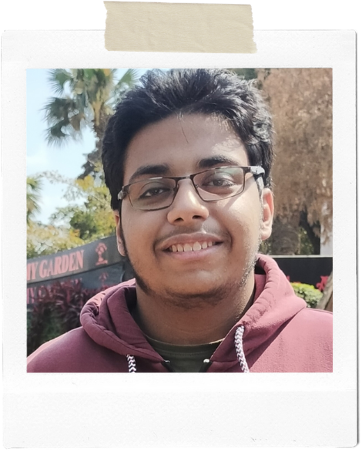
Team Members
Under the supervision of
Associate Professor: Iman M. Helal
TA: Eng Mira Rahem
Marwan Tamer Galal – Leader
Coordination
Documentation writing
Features and Requirements
System Specification
Database System
Backend Servers
Testing
03

Slide 5
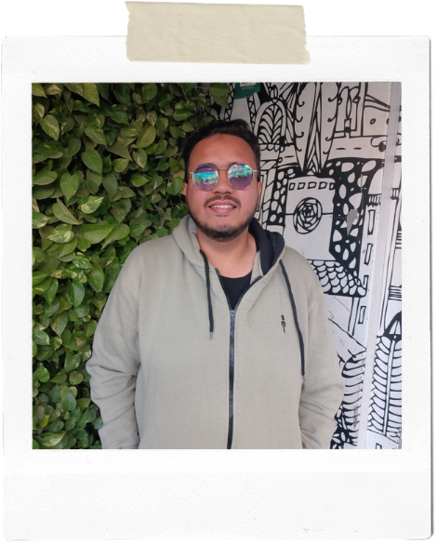
Team Members
Under the supervision of
Associate Professor: Iman M. Helal
TA: Eng Mira Rahem
Marwan Tamer Galal – Leader
Abdelrhman Mohamed Ahmed
Survey Creation
Responses Analysis
Documentation Editing
Features and Requirements
UX research / Usability Testing
UI Design / Prototyping
GP Presentation.
03

Slide 6

Team Members
Under the supervision of
Associate Professor: Iman M. Helal
TA: Eng Mira Rahem
Marwan Tamer Galal – Leader
Abdelrhman Mohamed Ahmed
Ahmed Mohamed Fayek
Use Case Descriptions
BPMN Diagrams
Class and ERD Diagrams
Mobile Application
Backend Server
03

Slide 7
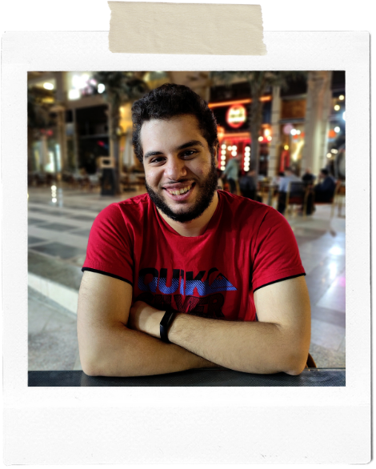
Team Members
Under the supervision of
Associate Professor: Iman M. Helal
TA: Eng Mira Rahem
Marwan Tamer Galal – Leader
Abdelrhman Mohamed Ahmed
Ahmed Mohamed Fayek
David Nael Nady
Func & non-Func Requirements
Use Case Descriptions
BPMN Diagrams
Sequence Diagrams
Backend Server
Mobile Application
03

Slide 8
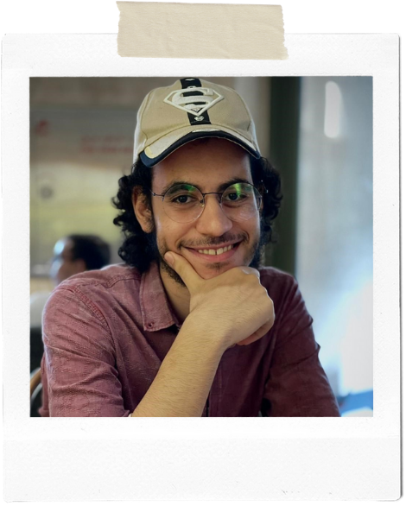
Team Members
Under the supervision of
Associate Professor: Iman M. Helal
TA: Eng Mira Rahem
Marwan Tamer Galal – Leader
Abdelrhman Mohamed Ahmed
Ahmed Mohamed Fayek
David Nael Nady
Mohamed Mahmoud Mohamed
Business plan
Use Case Diagrams
Front-end Application
Testing
03

Slide 9
Team Members
Under the supervision of
Associate Professor: Iman M. Helal
TA: Eng Mira Rahem
Marwan Tamer Galal – Leader
Abdelrhman Mohamed Ahmed
Ahmed Mohamed Fayek
David Nael Nady
Mohamed Mahmoud Mohamed
Business plan
Use Case Diagrams
Front-end Application
Testing
03

Slide 10

Introduction
Online learning became essential during the COVID-19 pandemic, but not all educational institutions in Egypt had adequate solutions for it. This presentation will examine the gap in the market for online learning frameworks and propose a cost-effective and user-friendly approach that suits the current and future generations.
04

Slide 11

Problem
The COVID-19 outbreak exposed a gap in the Egyptian market of education for online teaching services.
Small institutions developed their own systems, while large institutions bought professional ones.
Four years later, there is still no affordable and efficient solution for this gap.
05

Slide 12

Motivation
We aim to create an LMS platform that is tailored to the Egyptian educational context and needs.
Our platform will enable students, teachers, and System Admins to perform their tasks effectively and efficiently, while saving resources and increasing accessibility.
06

Slide 13

Competitor Analysis
We analyzed existing solutions such as blackboard and google classroom, and found that they have strengths and weaknesses, but none of them are suitable for Egyptian users.
07

Slide 14
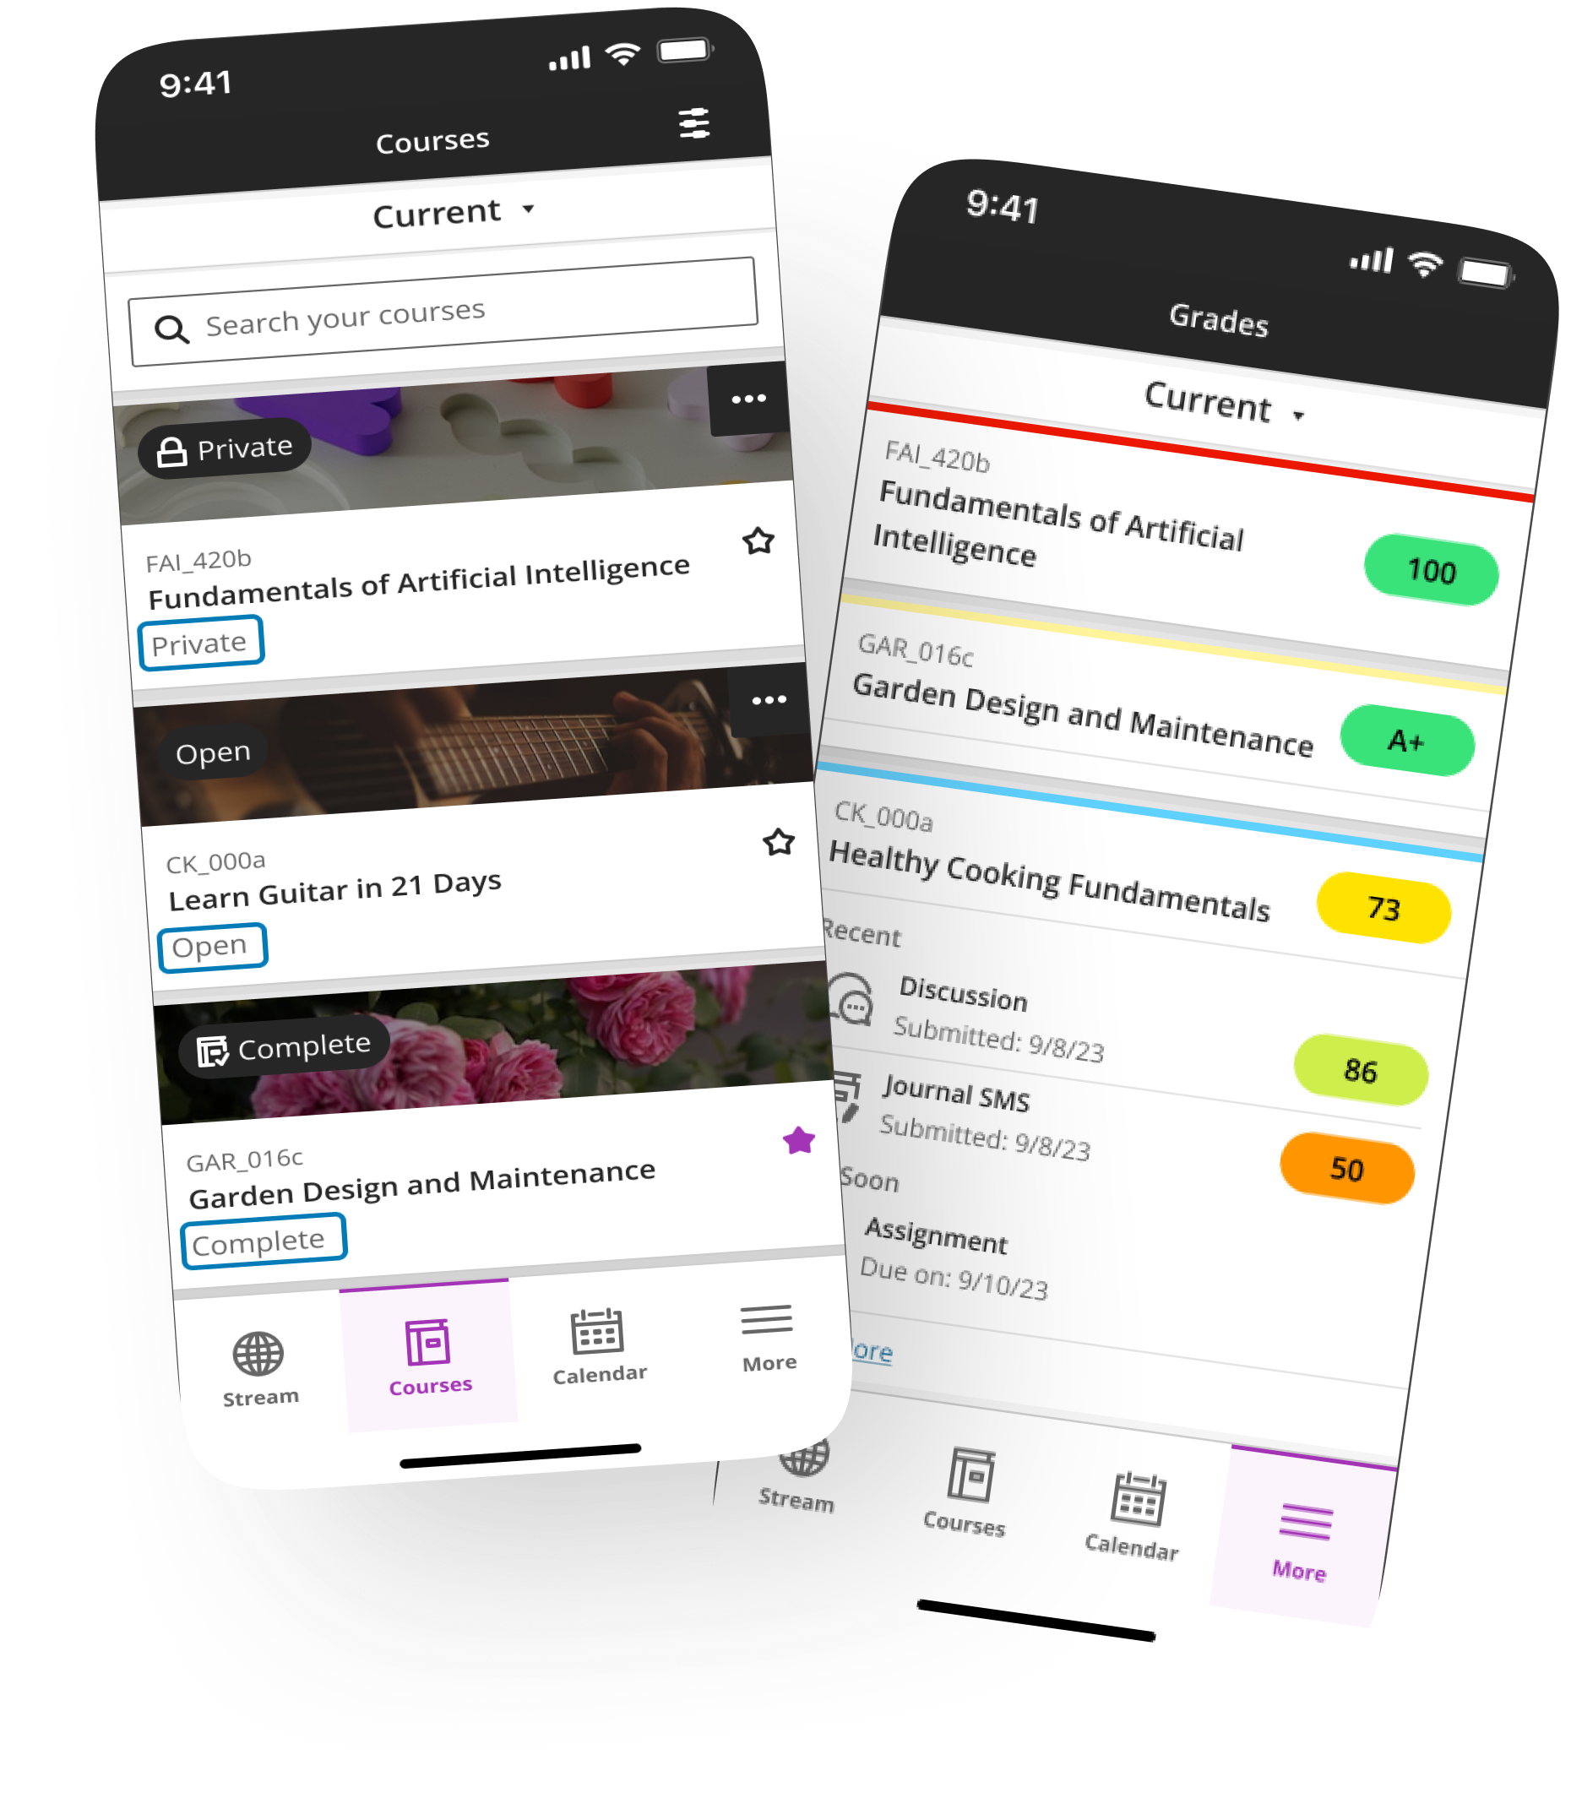

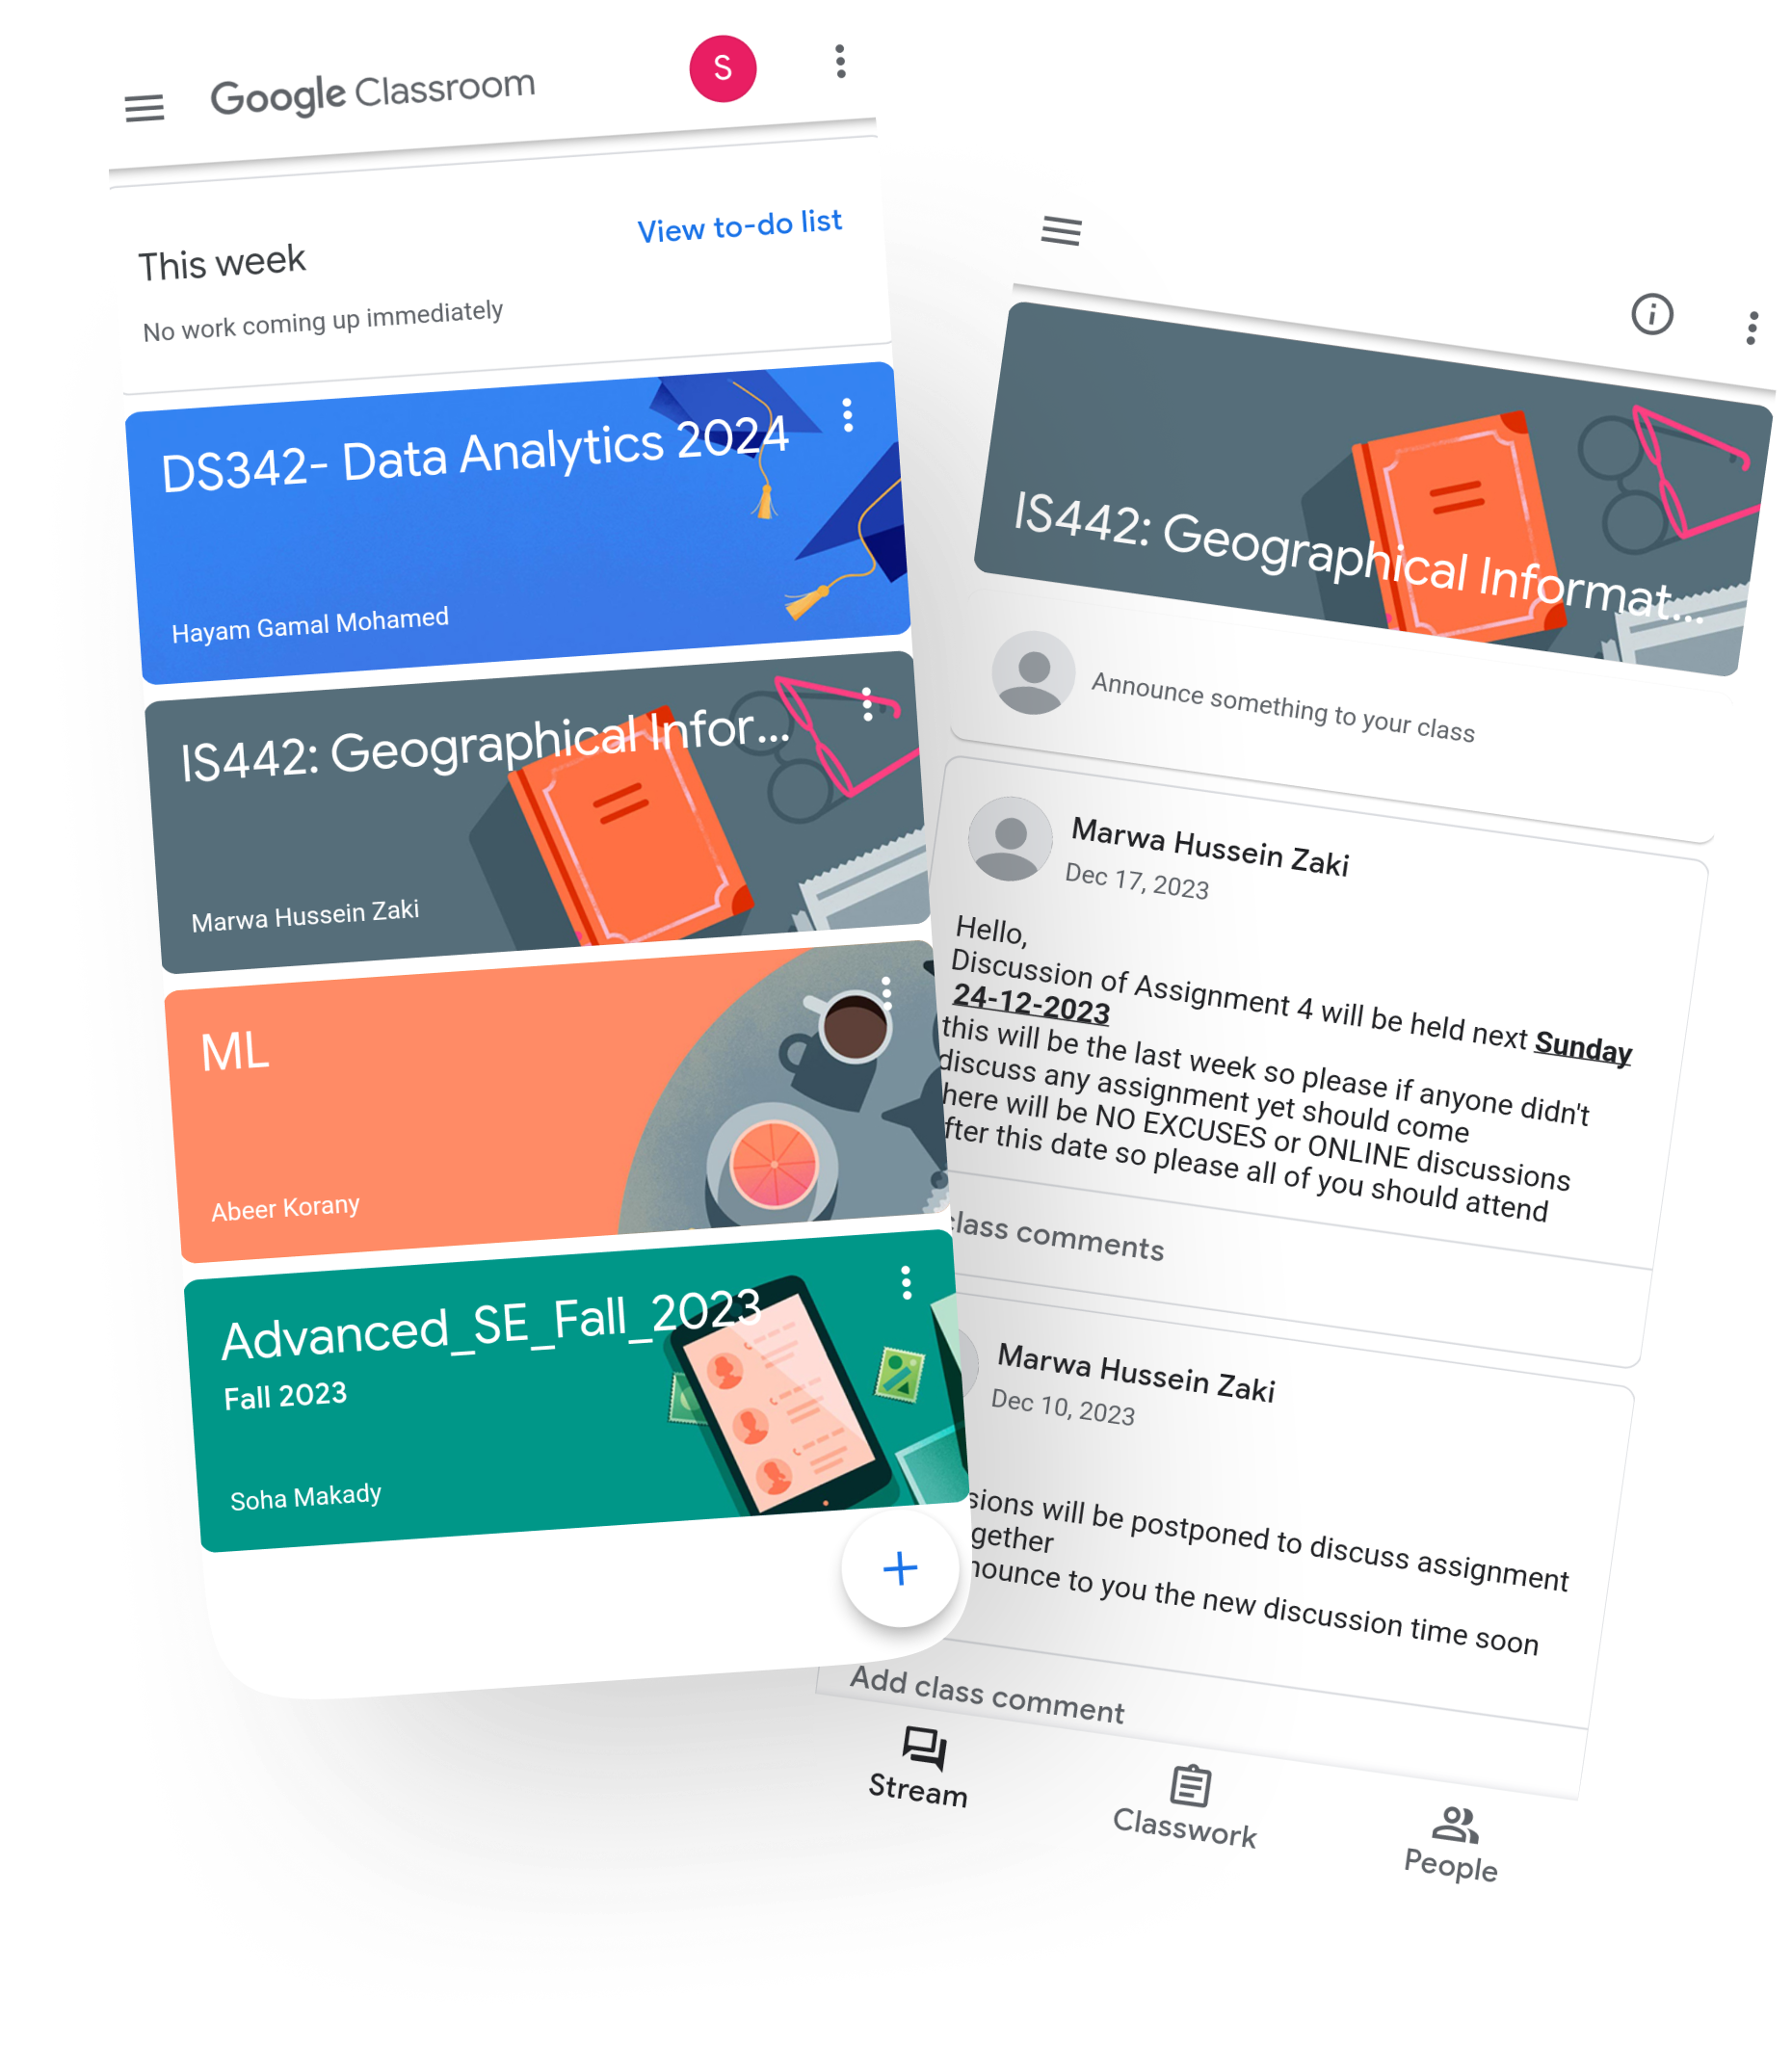
Blackboard Learn
Strengths
Popular LMS in education
Central system for all learning
Integrates with third-party tools
Supports multiple learning modes
Weaknesses
Clunky and outdated user interface
No innovation or flexibility
Expensive and complex license
Many technical problems
Scan Me
08

Slide 15

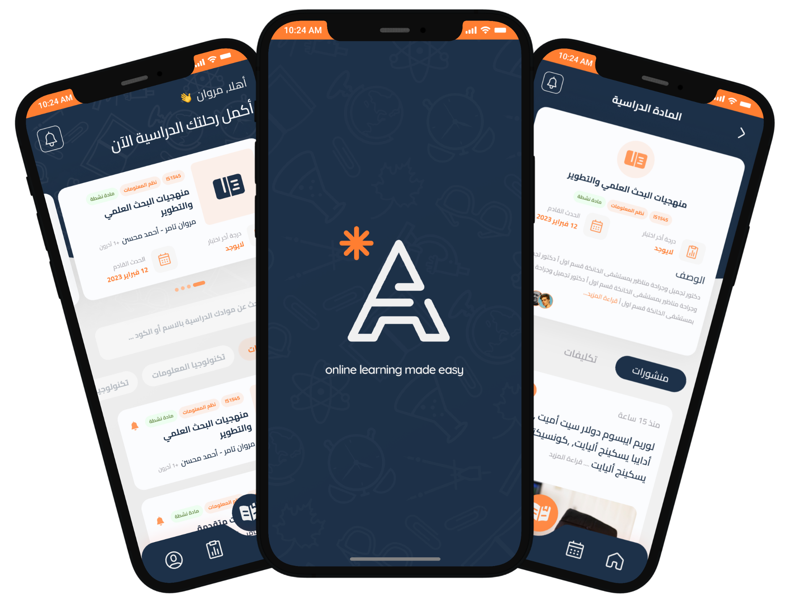
Google Classroom
Strengths
Easy integration with Google products
Free and accessible universally
Features for interactive online learning
Weaknesses
Limited LMS customization
Users’ data privacy concerns
Glitches affect learning quality
Scan Me
09

Slide 16
Proposed solution
We propose a Learning Management System (LMS) that is both student and staff-oriented.
This system includes:
Allowing teachers to post materials, quizzes, etc. and interact with students
An efficient course Management system for administration to ensure timely awareness of deadlines.
10

Slide 17
Proposed solution
We propose a Learning Management System (LMS) that is both student and staff-oriented.
This system includes:
An analysis tool for course and student outcomes, improving learning and reducing work.
Customizable user interface to cater to individual preferences and requirements.
10

Slide 18
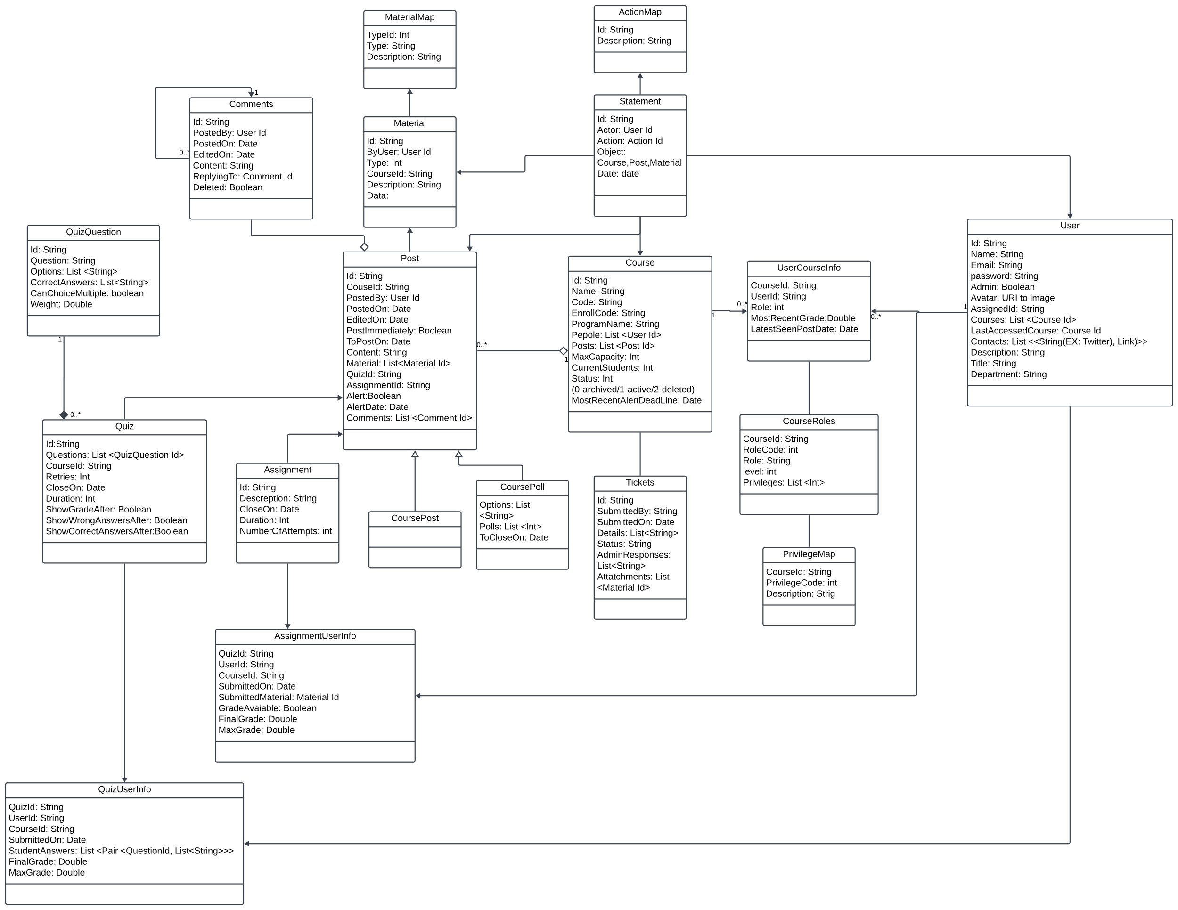
ERD
11

Slide 19

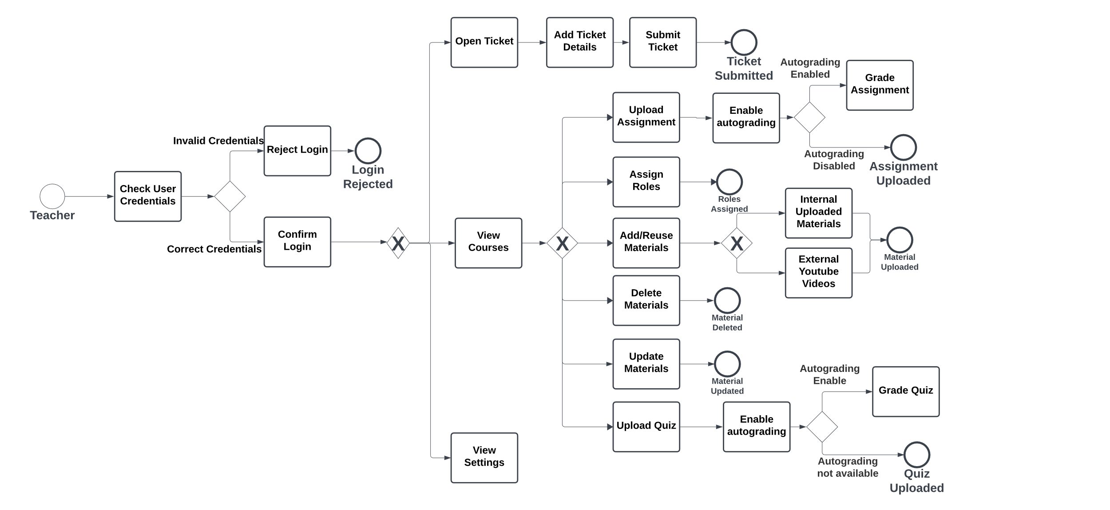
BPMN
12

Slide 20
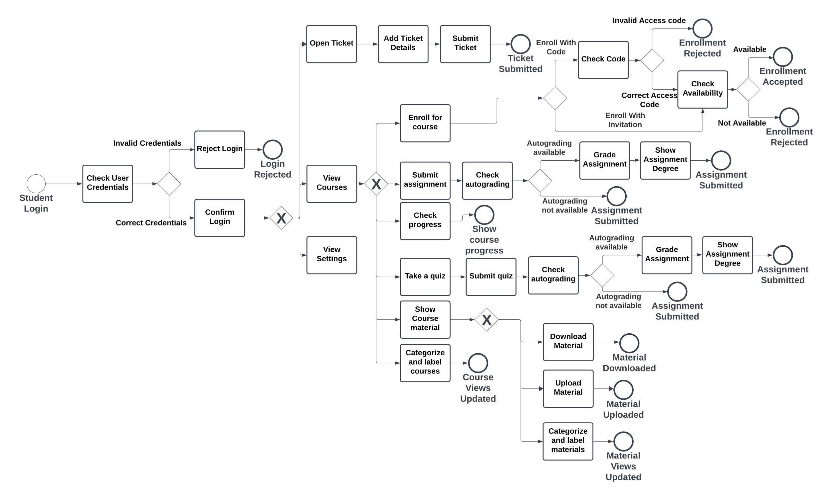

BPMN
Scan Me
13

Slide 21














Technologies
Documentation
Design
Implementation
14

Slide 22

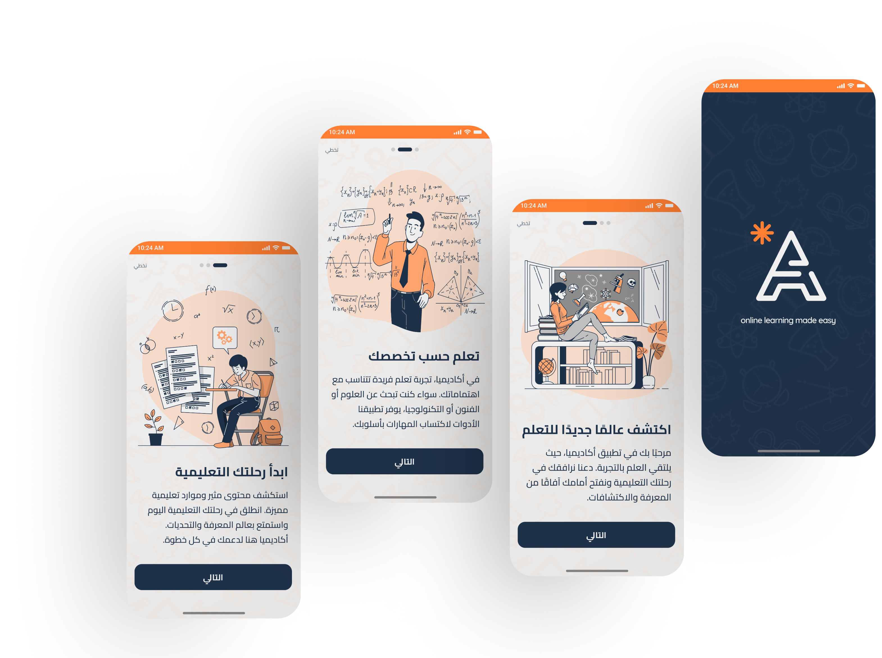

UX Design Principles
Simplicity: It is intuitive and easy to use for the user, without requiring any training.
Usability: It minimizes the number of steps needed to perform frequent tasks.
Accessibility: It allows the user to adjust the UI elements according to their personal preferences or needs, such as font size, color contrast, etc.
15

Slide 23

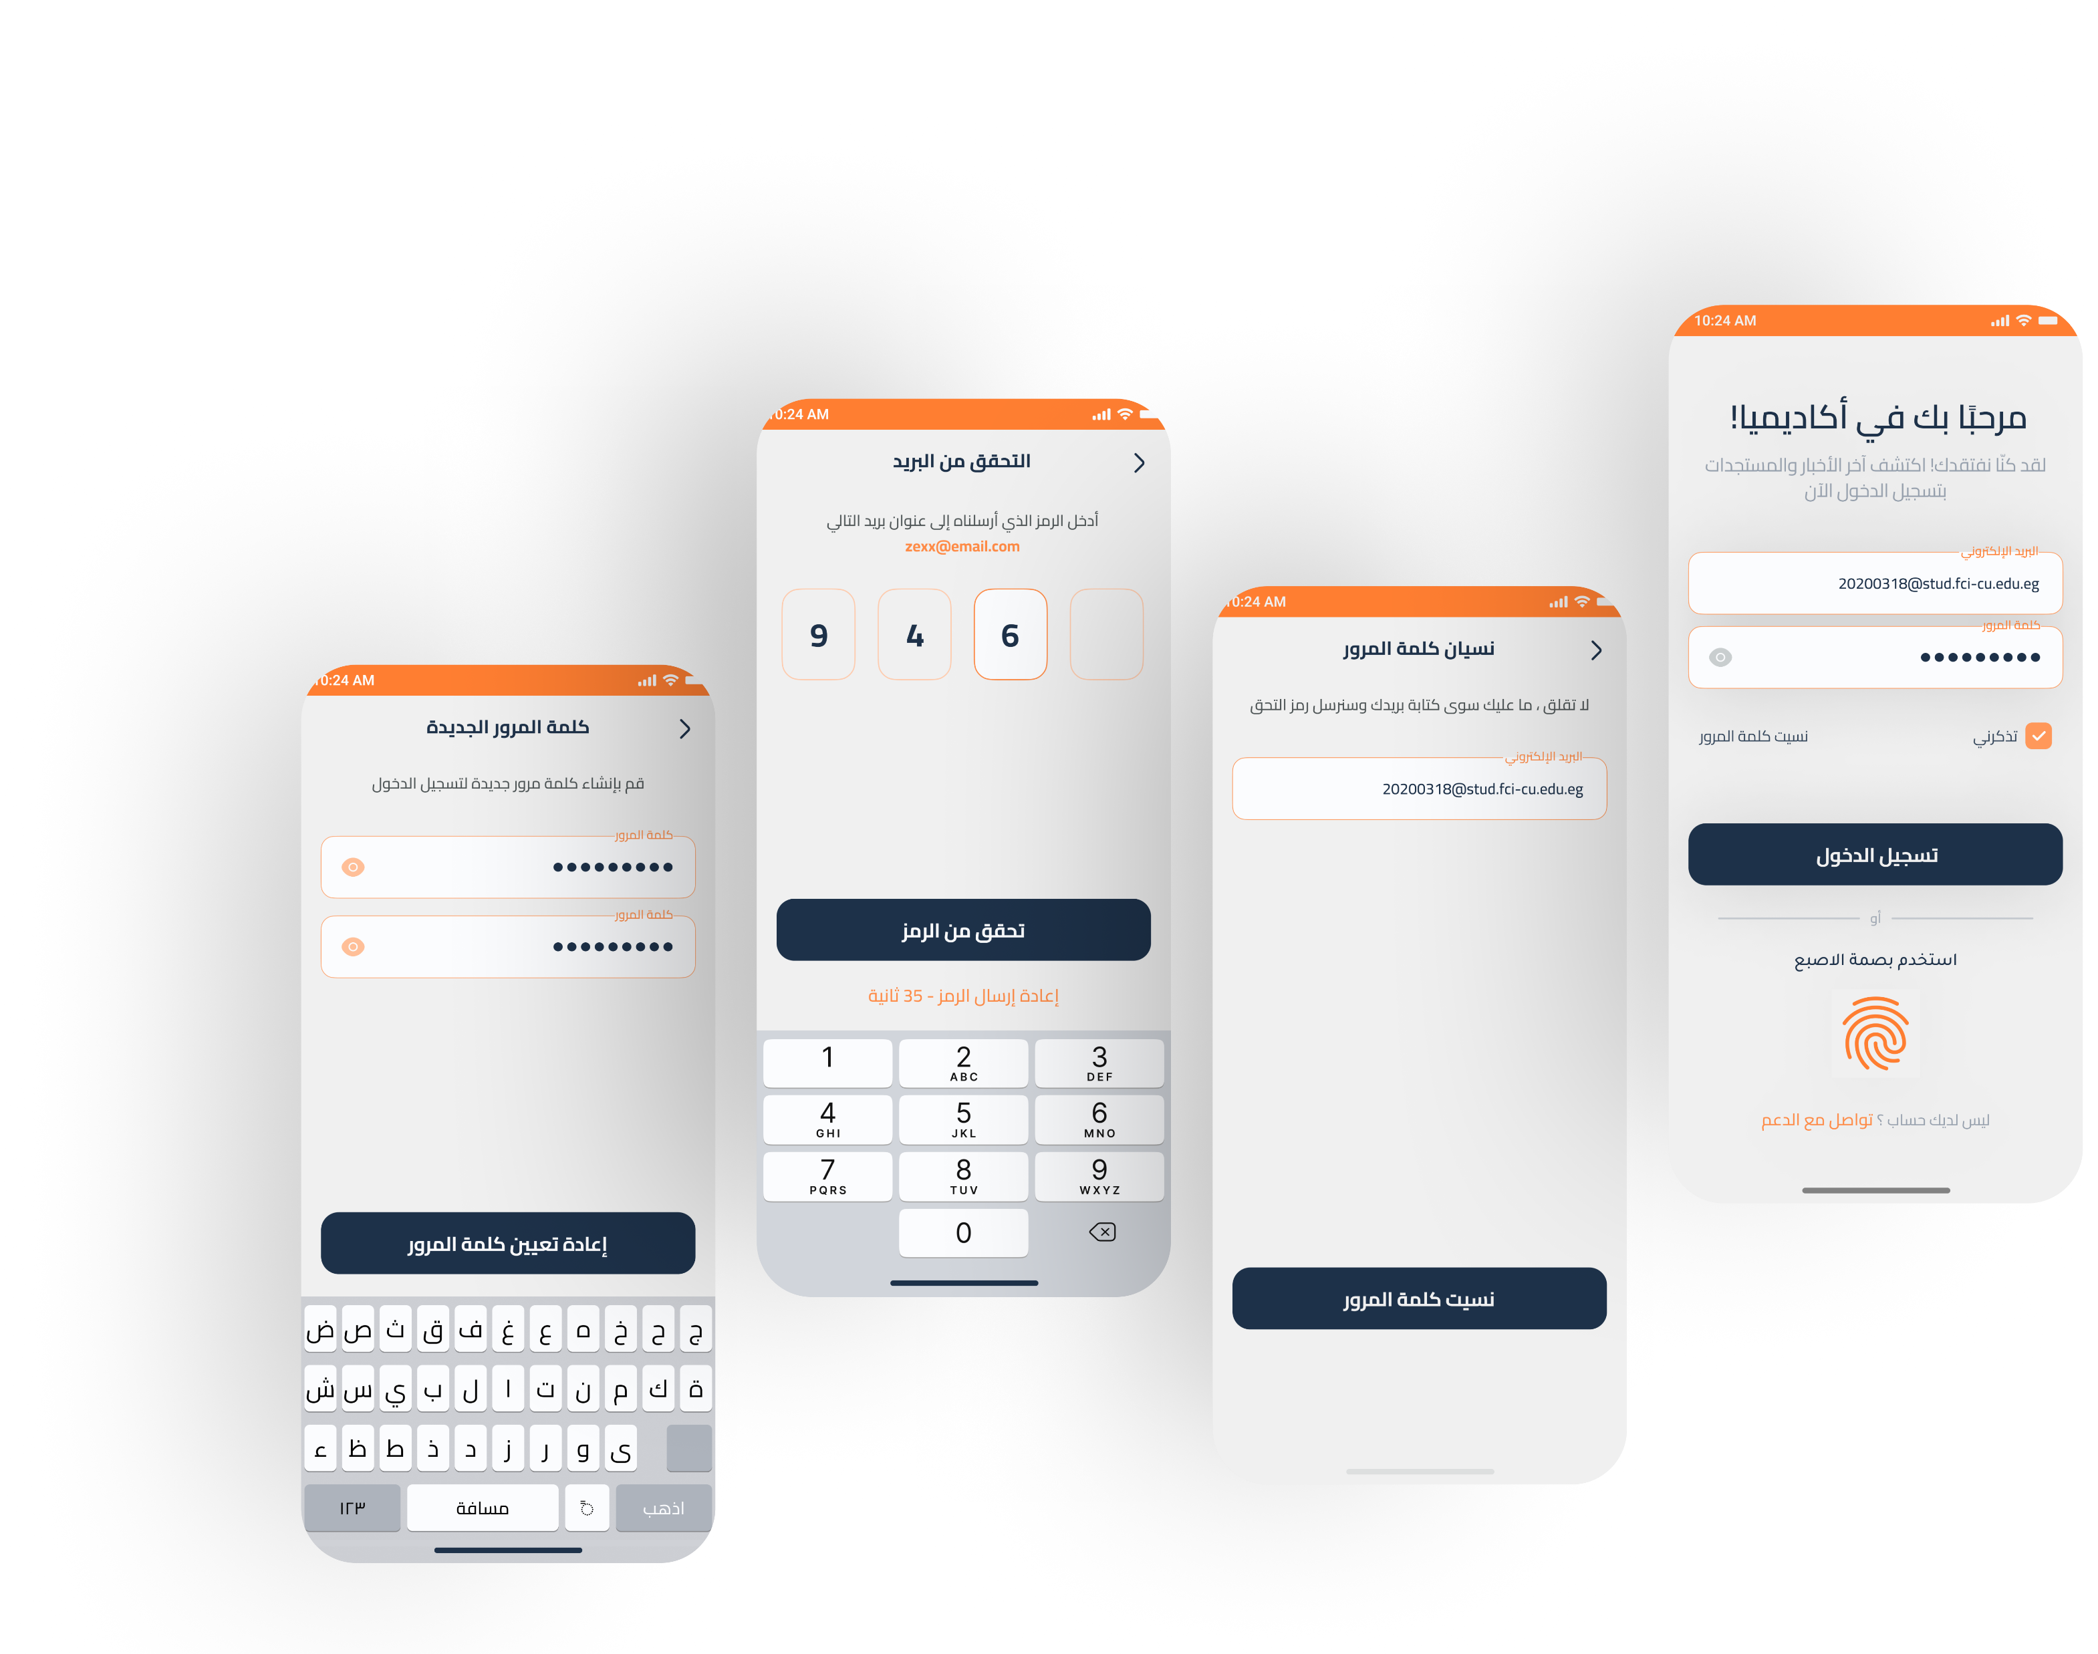
Student Light Arabic App
Onboarding Screen
Scan Me
16

Slide 24
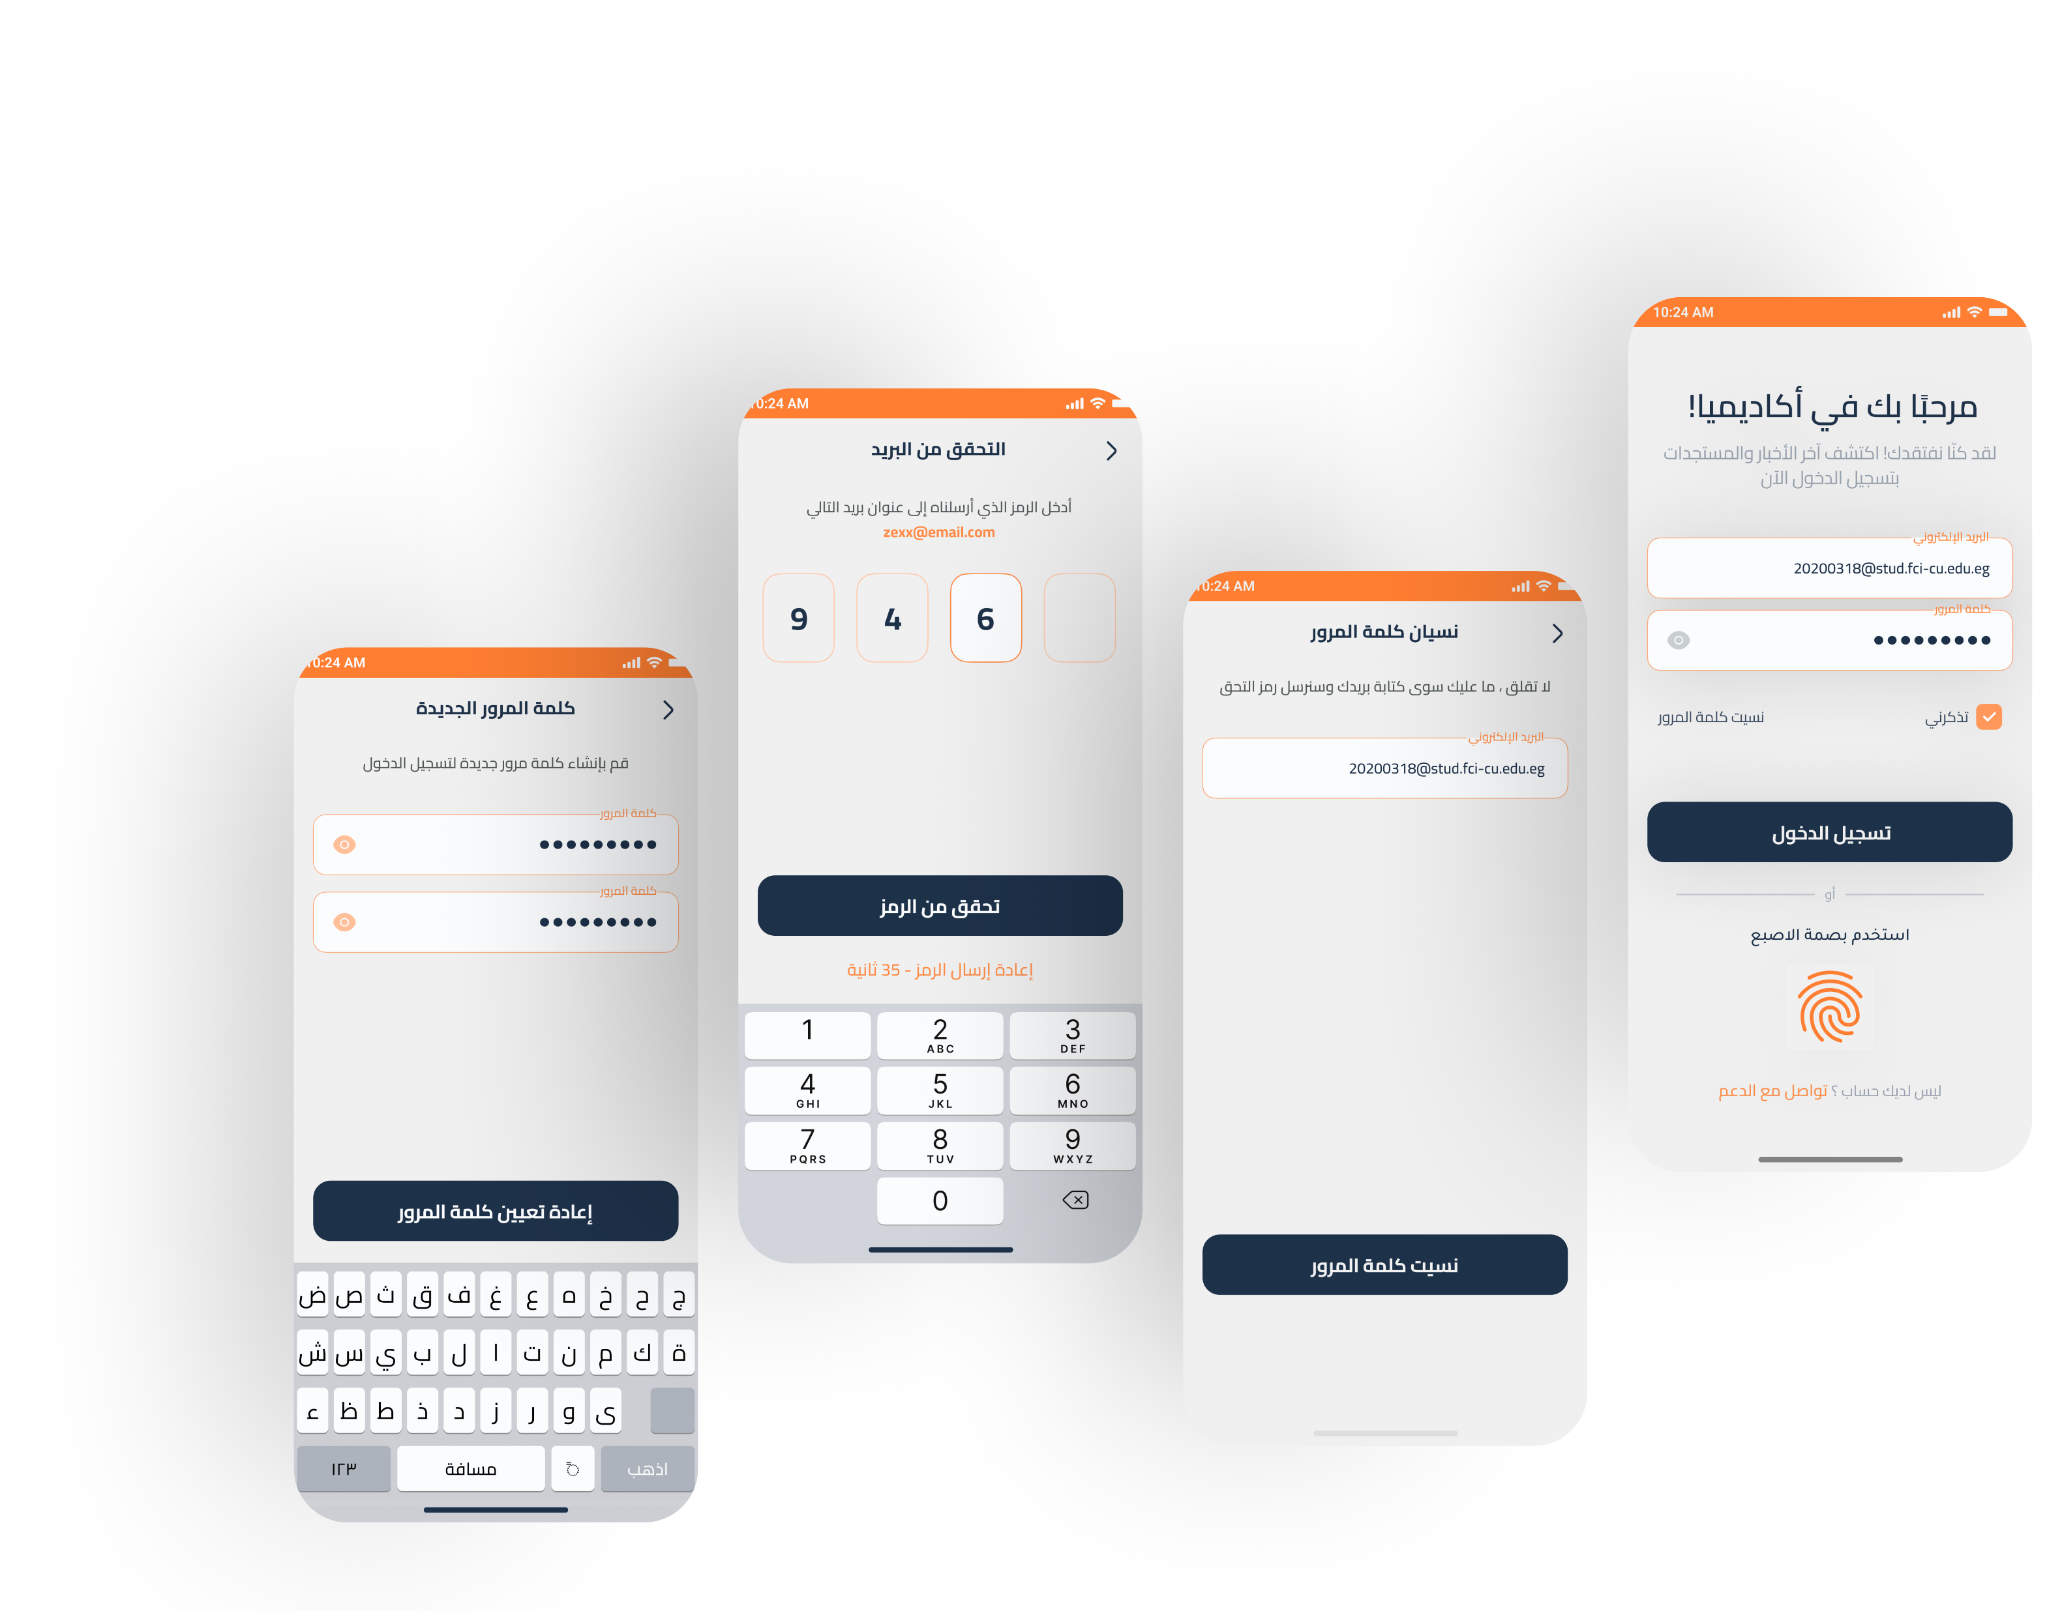
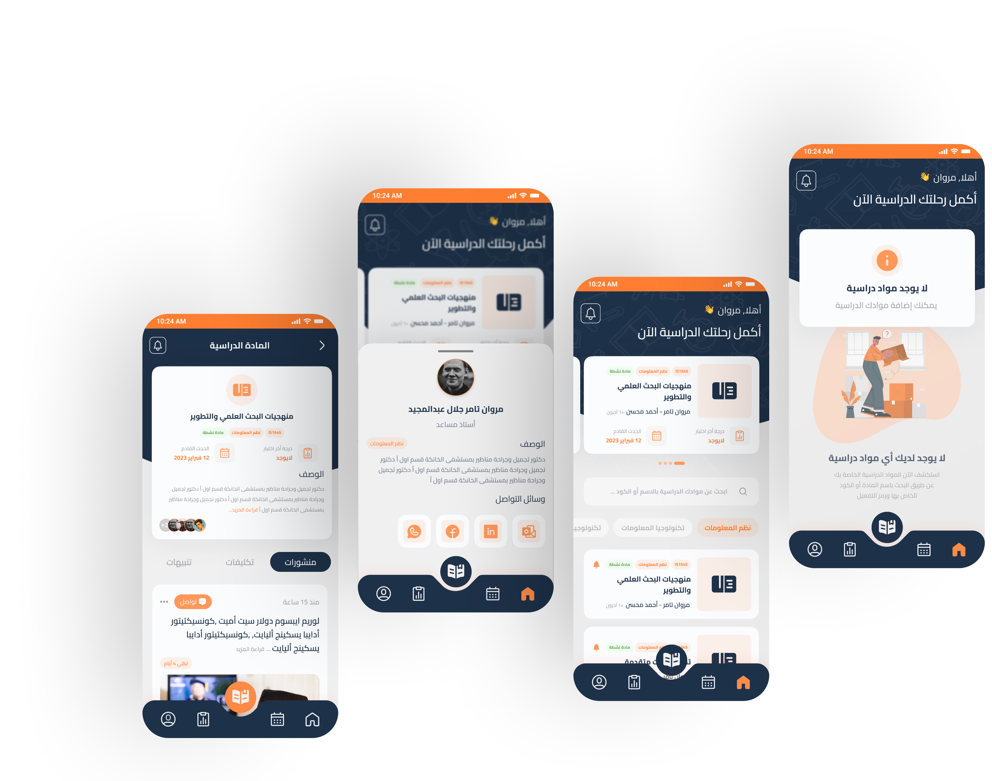
Student Light Arabic App
Authentication Screen
Scan Me
17

Slide 25
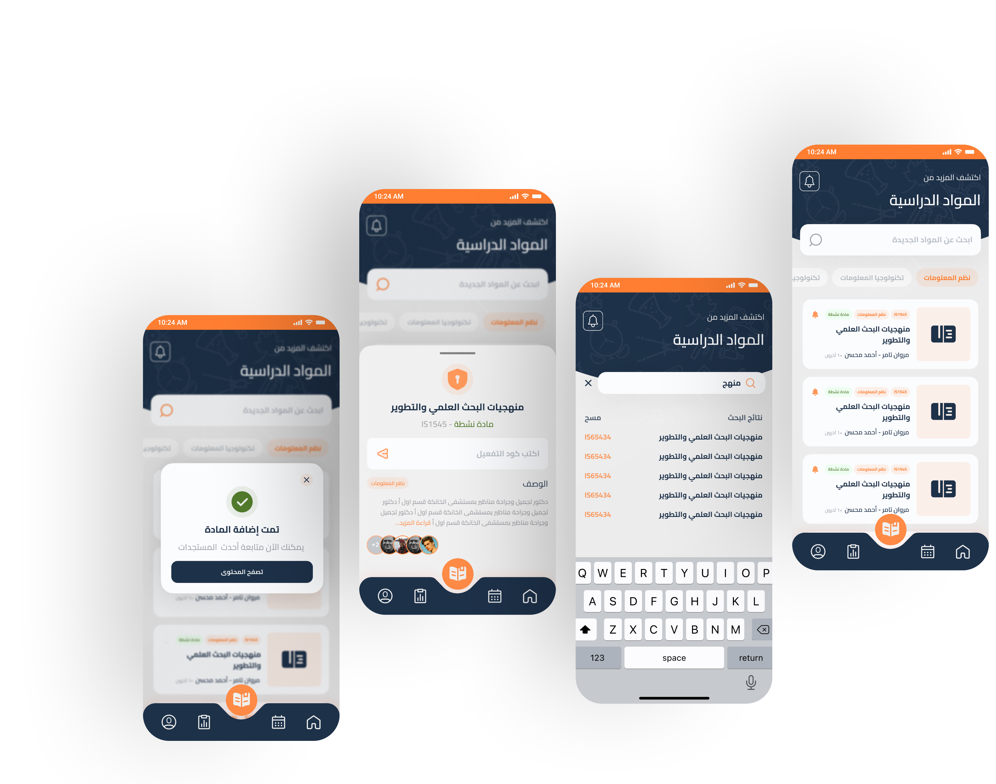
Student Light Arabic App
Home Screens
Scan Me
18

Slide 26
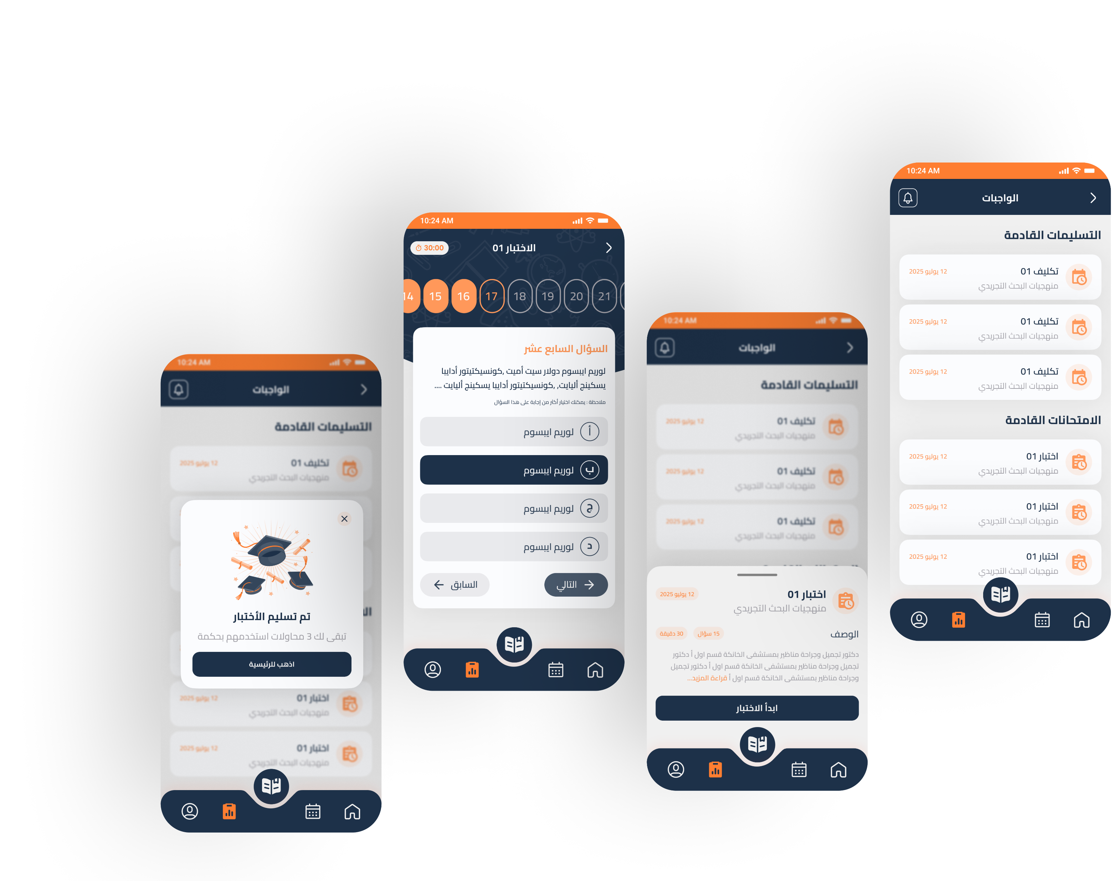
Student Light Arabic App
Courses Screens
Scan Me
19

Slide 27
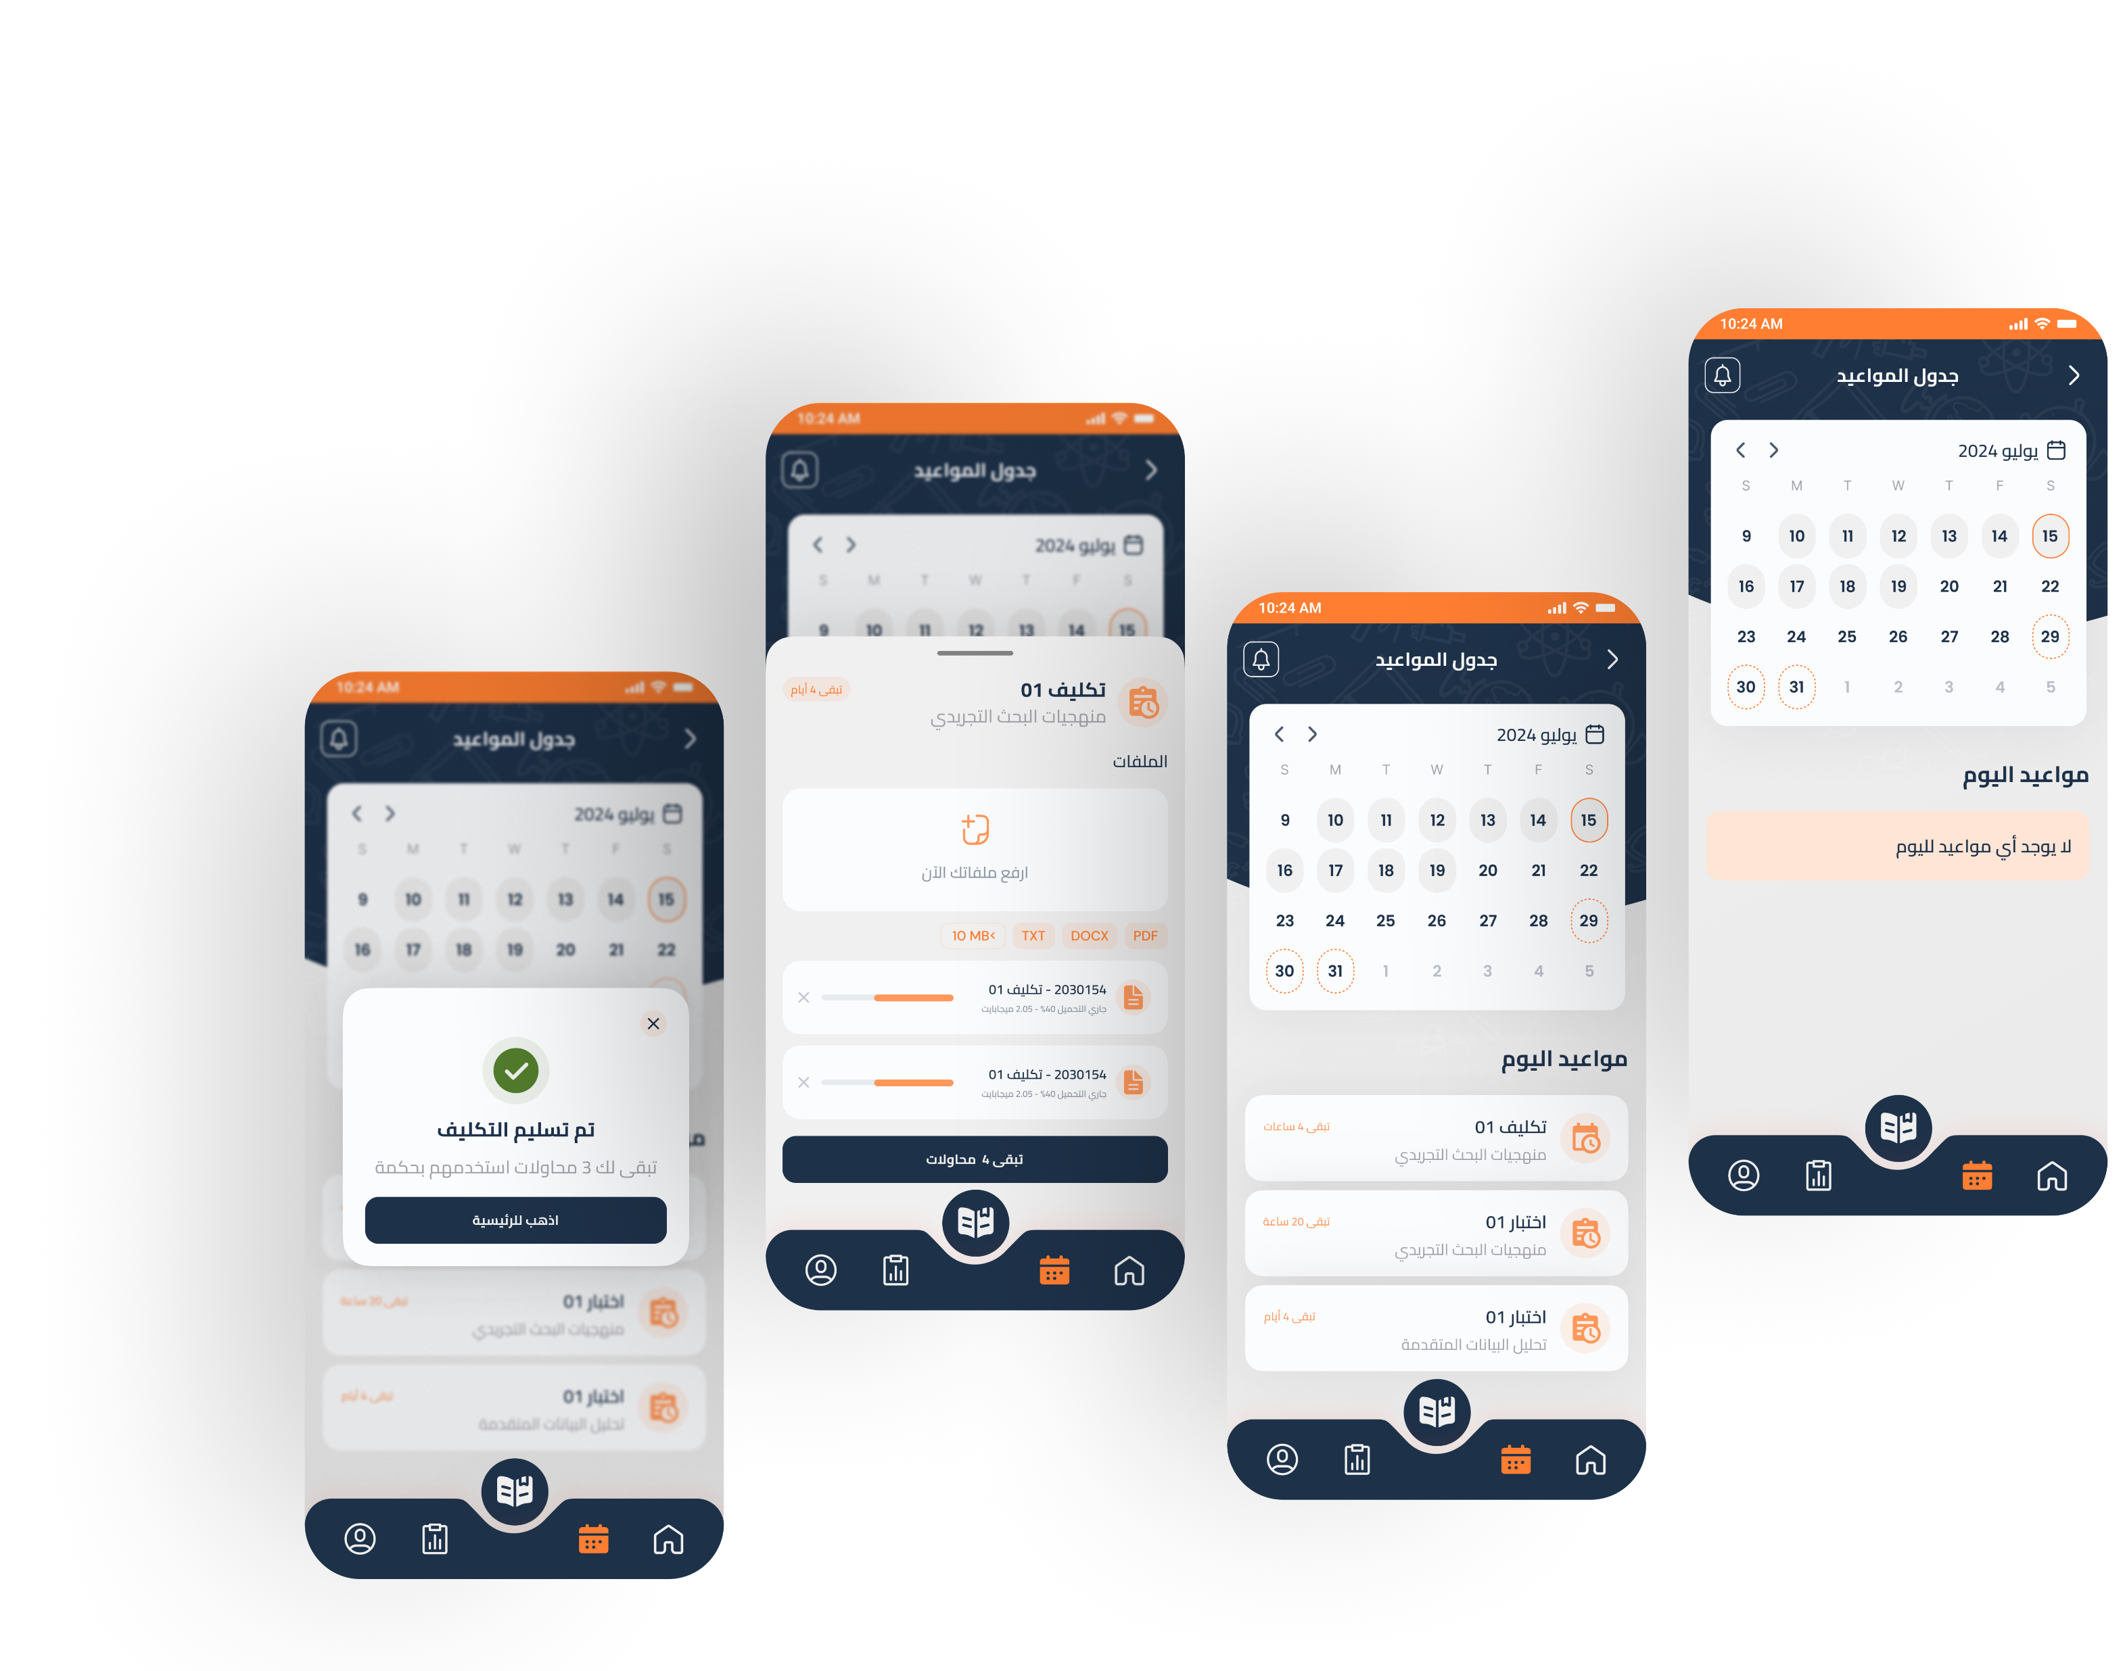
Student Light Arabic App
Quizzes Screens
Scan Me
20

Slide 28
Student Light Arabic App
Calendar Screens
Scan Me
21

Slide 29
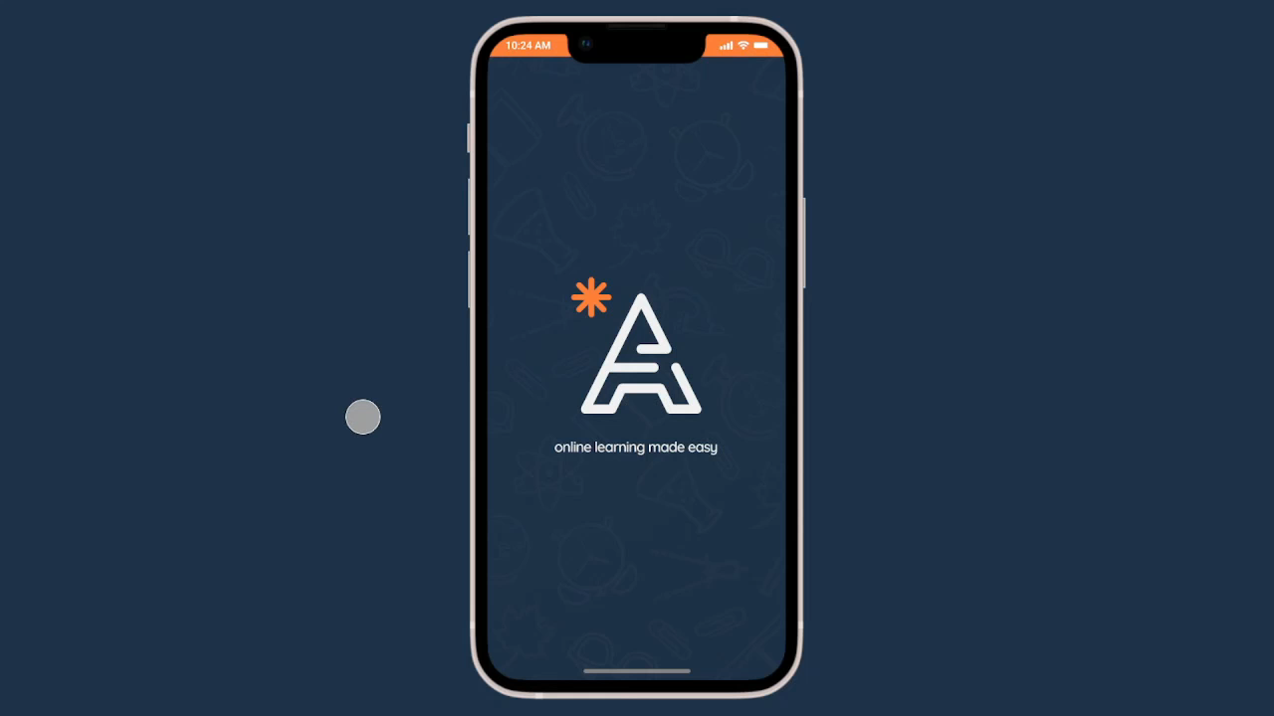
Student Light Arabic App
Prototype
Scan Me

Slide 30
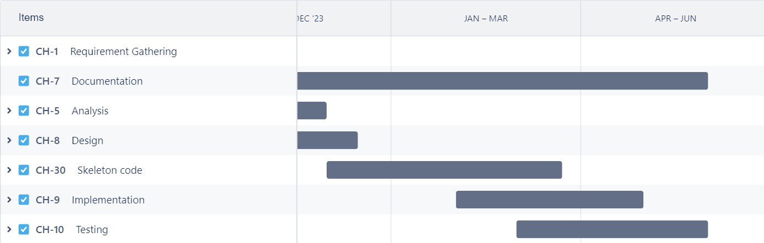
Timeline
13

Slide 31
Timeline
August
September
Proposal Writing and Approval – 1 Sprint
Survey design and publishing – 2 Sprints
Competitor Analysis – 2 Sprints
Survey Analysis – 3 Sprints
Competitor Analysis – 2 Sprints +2
SWOT Analysis – 1 Sprint
High level requirements – 2 Sprints
Documentation v01.0 - 1 Sprint
October
November
Func. & Non-func. Requirements– 2 Sprints
Desired Features and Priorities – 1 Sprint
Use Cases Descriptions – 3 Sprints
User Personas – 2 Sprints
UX Research – 3 Sprints
UX Research – 1 Sprint +3
Business Plan – 3 Sprints
Use Case Diagrams – 3 Sprints
ERD model - 2 Sprints
BPMN model - 2 Sprints
UI Wireframes - 3 Sprints
25

Slide 32

Timeline
December
January
API Modeling – 2 Sprints
Data Model Guidelines – 2 Sprints
Design UI System – 3 Sprints
Onboarding Implémentation – 2 Sprints
Documentation v02.0 - 2 Sprints
API Modeling (Update) – 2 Sprints +2
Data Model Guidelines (Update) – 2 Sprints +2
Server Implementation (API Routing) – 3 Sprints
Student app UI Screens – 2 Sprints
Web Authentication UI Screens – 1 Sprint
February
DB Configuration and Access– 1 Sprint
GP Presentation – 1 Sprint
Web Auth. Implementation – 1 Sprint
Student App Implementation – 3 Sprints
Student Web UI Screens – 2 Sprints
Documentation v03.0 - 2 Sprints
Student Web Implementation – 3 Sprints
25

Slide 33

Questions
26

Slide 34

Finally
Thank You
In conclusion, we express our gratitude. For additional information, please feel free to reach out to us.
Scan Me

Slide 35
Finally
Thank You
Scan Me
In conclusion, we express our gratitude. For additional information, please feel free to reach out to us.
27

Slide 36
Technologies
Microsoft Office
Google Survey
Lucid Chart
Trello
React.js – FrontEnd
Node.js - BackEnd Server
Mongo database
Flutter - Mobile App
Figma – UI/Prototyping
15

Slide 37

Main Features
Create and manage courses with ease and flexibility.
Tailor the UI to suit your preferences and needs.
Post quizzes, and announcements to engage learners and assess their progress.
Analyze course performance with detailed reports and feedback.
11

Slide 38
Proposed solution
We propose a Learning Management System (LMS) that is both student and staff-oriented.
This system includes:
Allowing teachers to post materials, quizzes, etc. and interact with students
An efficient course Management system for administration to ensure timely awareness of deadlines.
An analysis tool for course and student outcomes, improving learning and reducing work.
Customizable user interface to cater to individual preferences and requirements.
10

Slide 39

Proposed solution
Our solution to this issue is a student-centered and staff-friendly LMS.
With a focus on blog-like system, where users (teachers and such) post announcements, quizzes, assignments for students. And allowing students to organize those resources and get notified of any upcoming deadlines. And for managers to offer an analytical service to let them view how each course and student performed to help point out any shortcomings.
10

